Slide 1






Slide 2



We are Connect. A leading Multi-Academy Trust creating remarkable futures for thousands of pupils through educational excellence.
Pupils - 3486
Schools - 7
Staff - 7

Slide 3

Connect Digital Strategy
We work with our schools to achieve all four of the following essential and interrelated objectives that are central to success:
Anywhere, any device, any time for all stakeholders.
Engaging and Empowering learning through technology
Technology is well used to integrate parents into all aspects of school life
Creativity and innovation in the heart of learning

Slide 4




SELFIE EVALUATION
REVIEW THE REPORT
1
DEVELOP
2
3
EVALUATE IMPACT
4

Slide 5



IDENTIFY
LEARNING PROCESS
REFLECT
IMPLEMENT

Slide 6
IDENTIFY
Selfie evaluation
Leadership
Pupils
Staff
Parent
1. LEADERSHIP AND VISION
2.DIGITAL TECHNOLOGY INTEGRATION IN THE CURRICULUM
3.SCHOOL DIGITAL TECHNOLOGY CULTURE
4. CONTINUING PROFESSIONAL DEVELOPMENT
5. RESOURCES AND INFRASTRUCTURE

Slide 7
IDENTIFY
Focus on particular Area from the SELFIE report
Two groups:
Educational Thinking
Assessment
-Self reflection on learning -Feedback for Learning -Assigning skills -CPD
Infrastructure
-Data protection 2 Factor -Filtering and monitoring system -Back up for the cloud
Operational Thinking

Slide 8
IDENTIFY
Thinking Process - Pre- action plan
1
2
3
4
5
Identify the gap
Teams
The group of people who participate in the action learning process
Action- Learning coach
Support organising
Action taken
Creating action plan
Teams to questioning
ask the right questions to get deep insights

Slide 9
Implementation- Creating an action plan
1
2
3
4
5
Understand your current state (Aduit SELIF) What is the current state of digital learning in your organization? What are your strengths and weaknesses? What are your opportunities and targets? by conducting a assessment, surveying your stakeholders, and reviewing your data.
Set your goals. What do you want to achieve with your digital action plan? Do you want to improve student outcomes? Increase access to digital learning? Develop digital skills in your students and staff? Once you know your goals, you can start to develop strategies to achieve them.
Identify your priorities. Not all of your goals will be equal. Some will be more important and urgent than others. Consider your resources and your timeline when setting your priorities.
Develop strategies and actions. For each of your priorities, develop specific strategies and actions that you will take to achieve them. Be as specific as possible and include timelines and deadlines.
Implement your plan. Once you have developed your plan, it's time to start implementing it. This will involve communicating your plan to your stakeholders, providing training and support, and monitoring and evaluating your progress.

Slide 10




Implementation
It is important to approach this as a school-wide initiative, and ensure it is included in your School Development Plan.
Connect Education Trust -Education Action Plan -Operational Action Plan
INDIVIDUAL SCHOOL ACTION PLAN

Slide 11
Reflection on your action plan
1
2
3
4
5
Review your goals and priorities. What were your goals and priorities when you developed your digital action plan? Have they changed since then? If so, why?
Assess your progress. How far have you come towards achieving your goals and priorities? What has worked well? What challenges have you faced?
Gather feedback and evidences from your stakeholders. What do your students, teachers, parents, administrators, and community members think of your digital action plan? What feedback do they have?
Analyze your data. What data do you have on the impact of your digital action plan? For example, have student outcomes improved? Has access to digital learning increased? Have digital skills developed in students and staff?
Cycle will continue to Identify areas for improvement. Based on your assessment, feedback, and data, identify areas where you can improve your digital action plan.

Slide 12
Reflecting
Digital School Portfolio
1. LEADERSHIP AND VISION
2.DIGITAL TECHNOLOGY INTEGRATION IN THE CURRICULUM
4. CONTINUING PROFESSIONAL DEVELOPMENT
3.SCHOOL DIGITAL TECHNOLOGY CULTURE
5. RESOURCES AND INFRASTRUCTURE
Notes:
Show the portfolio

Slide 13
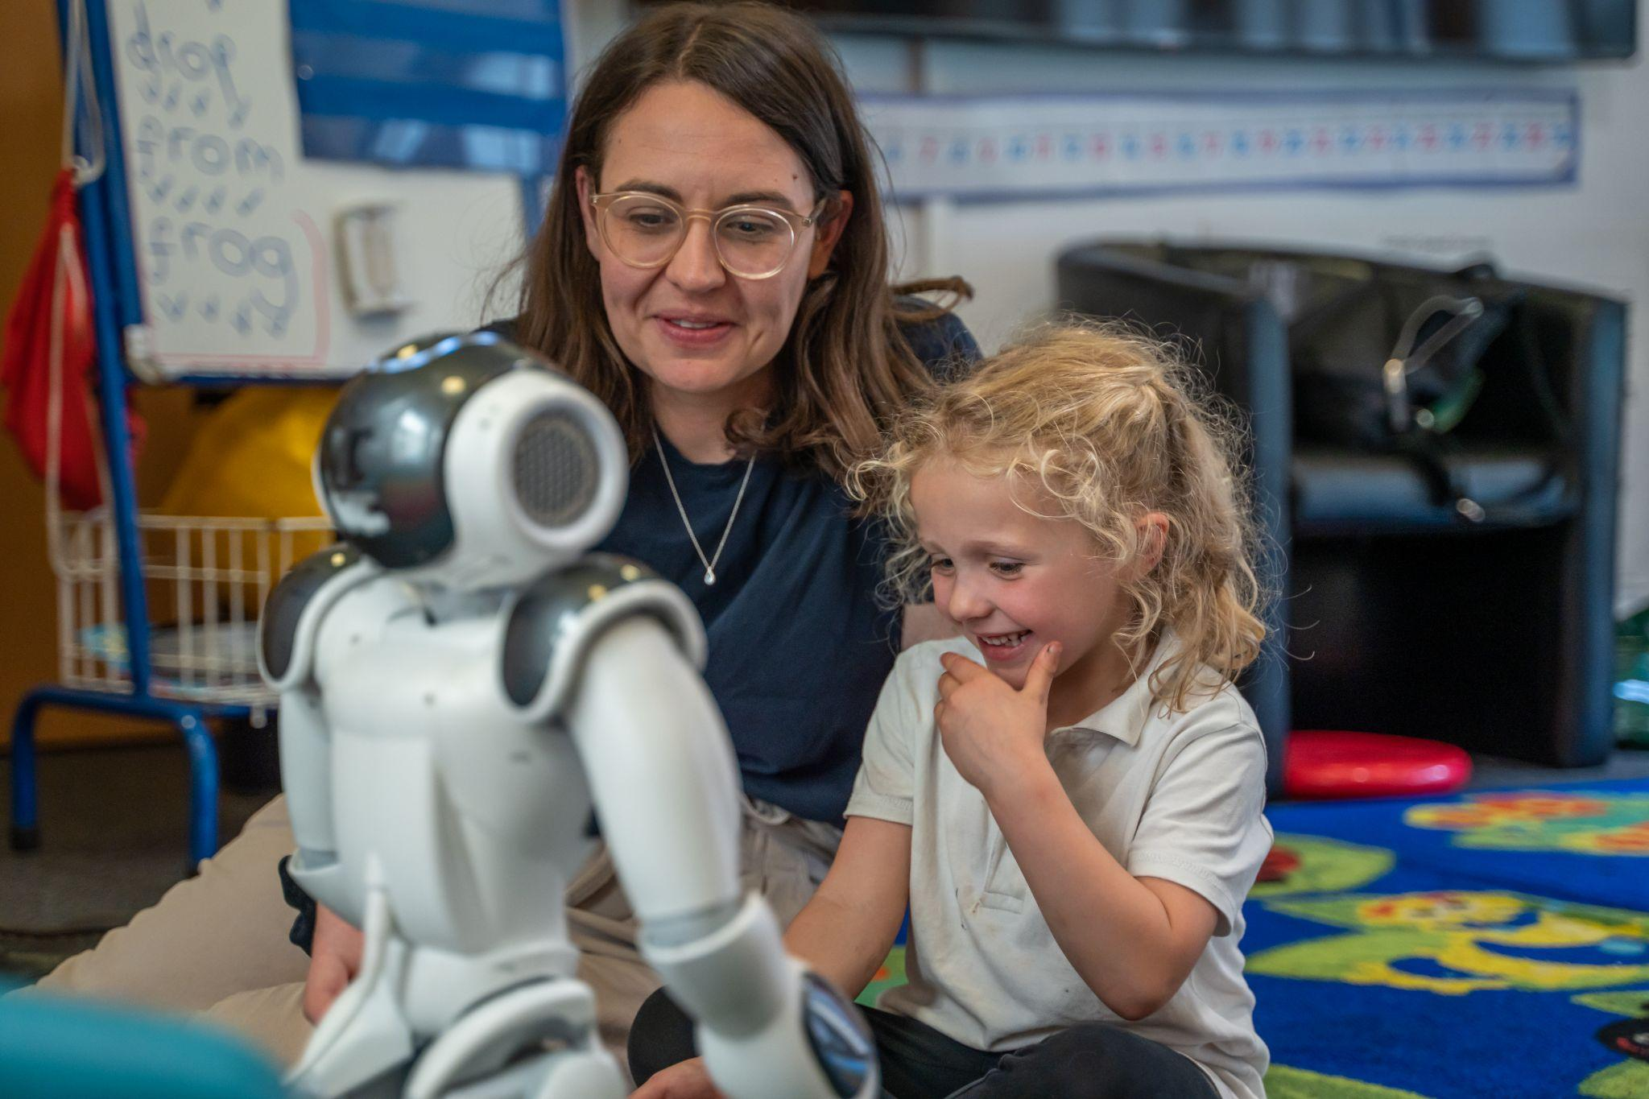
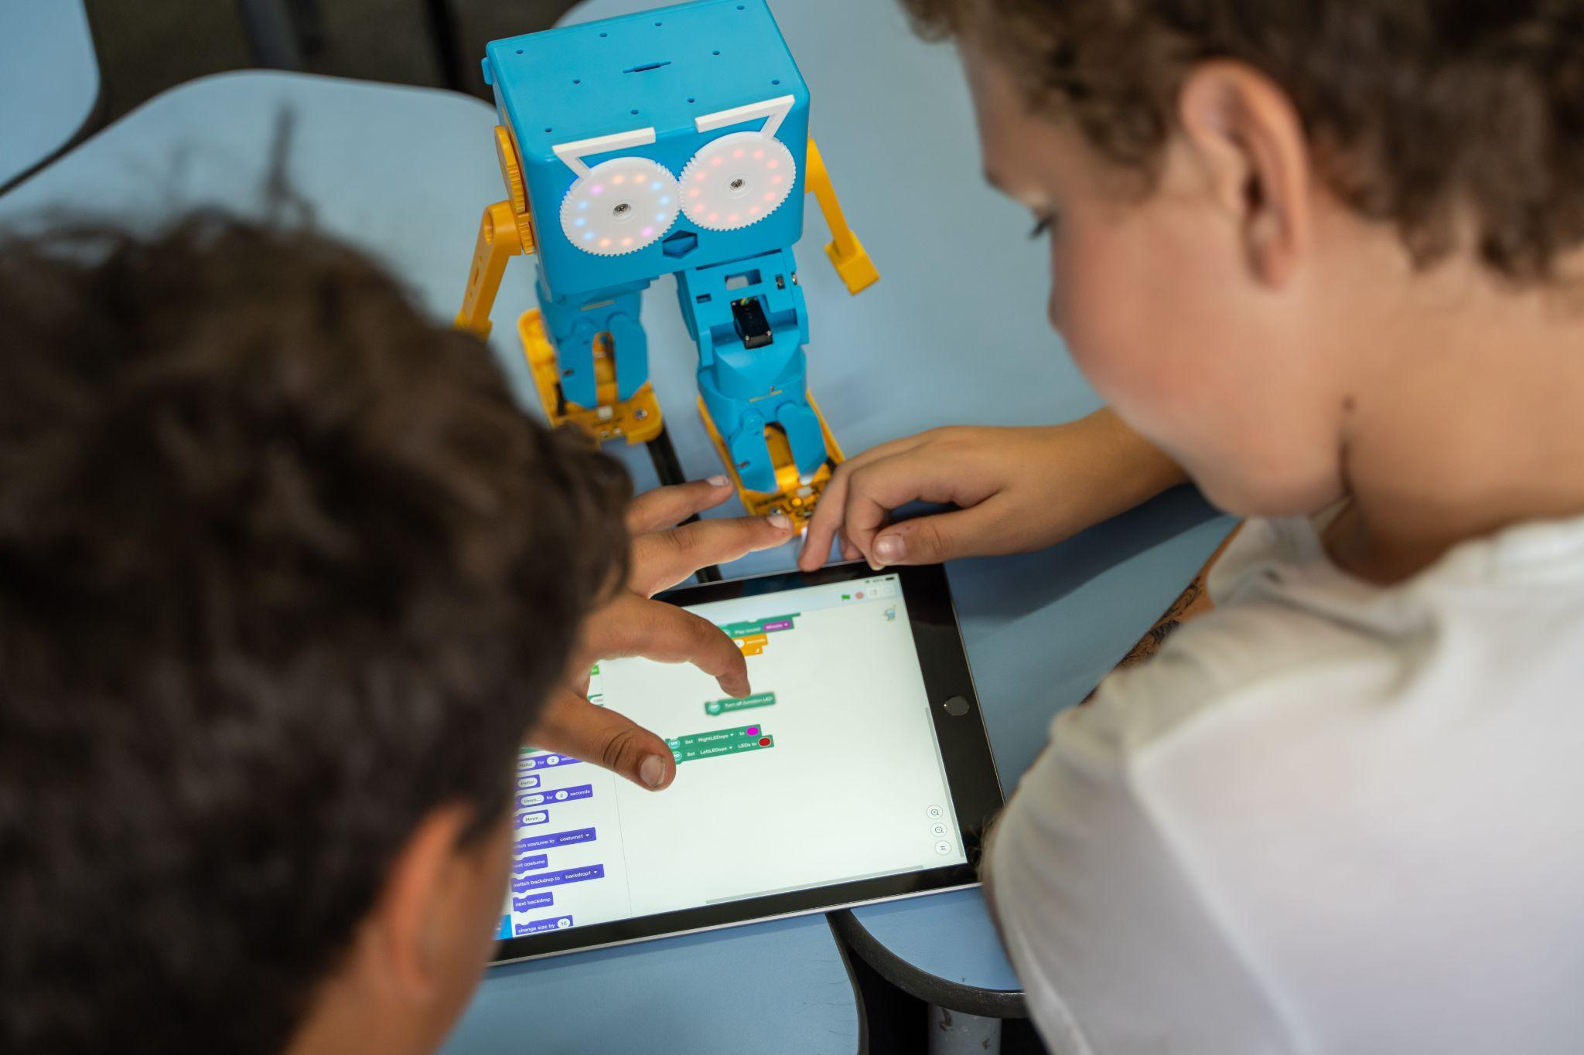
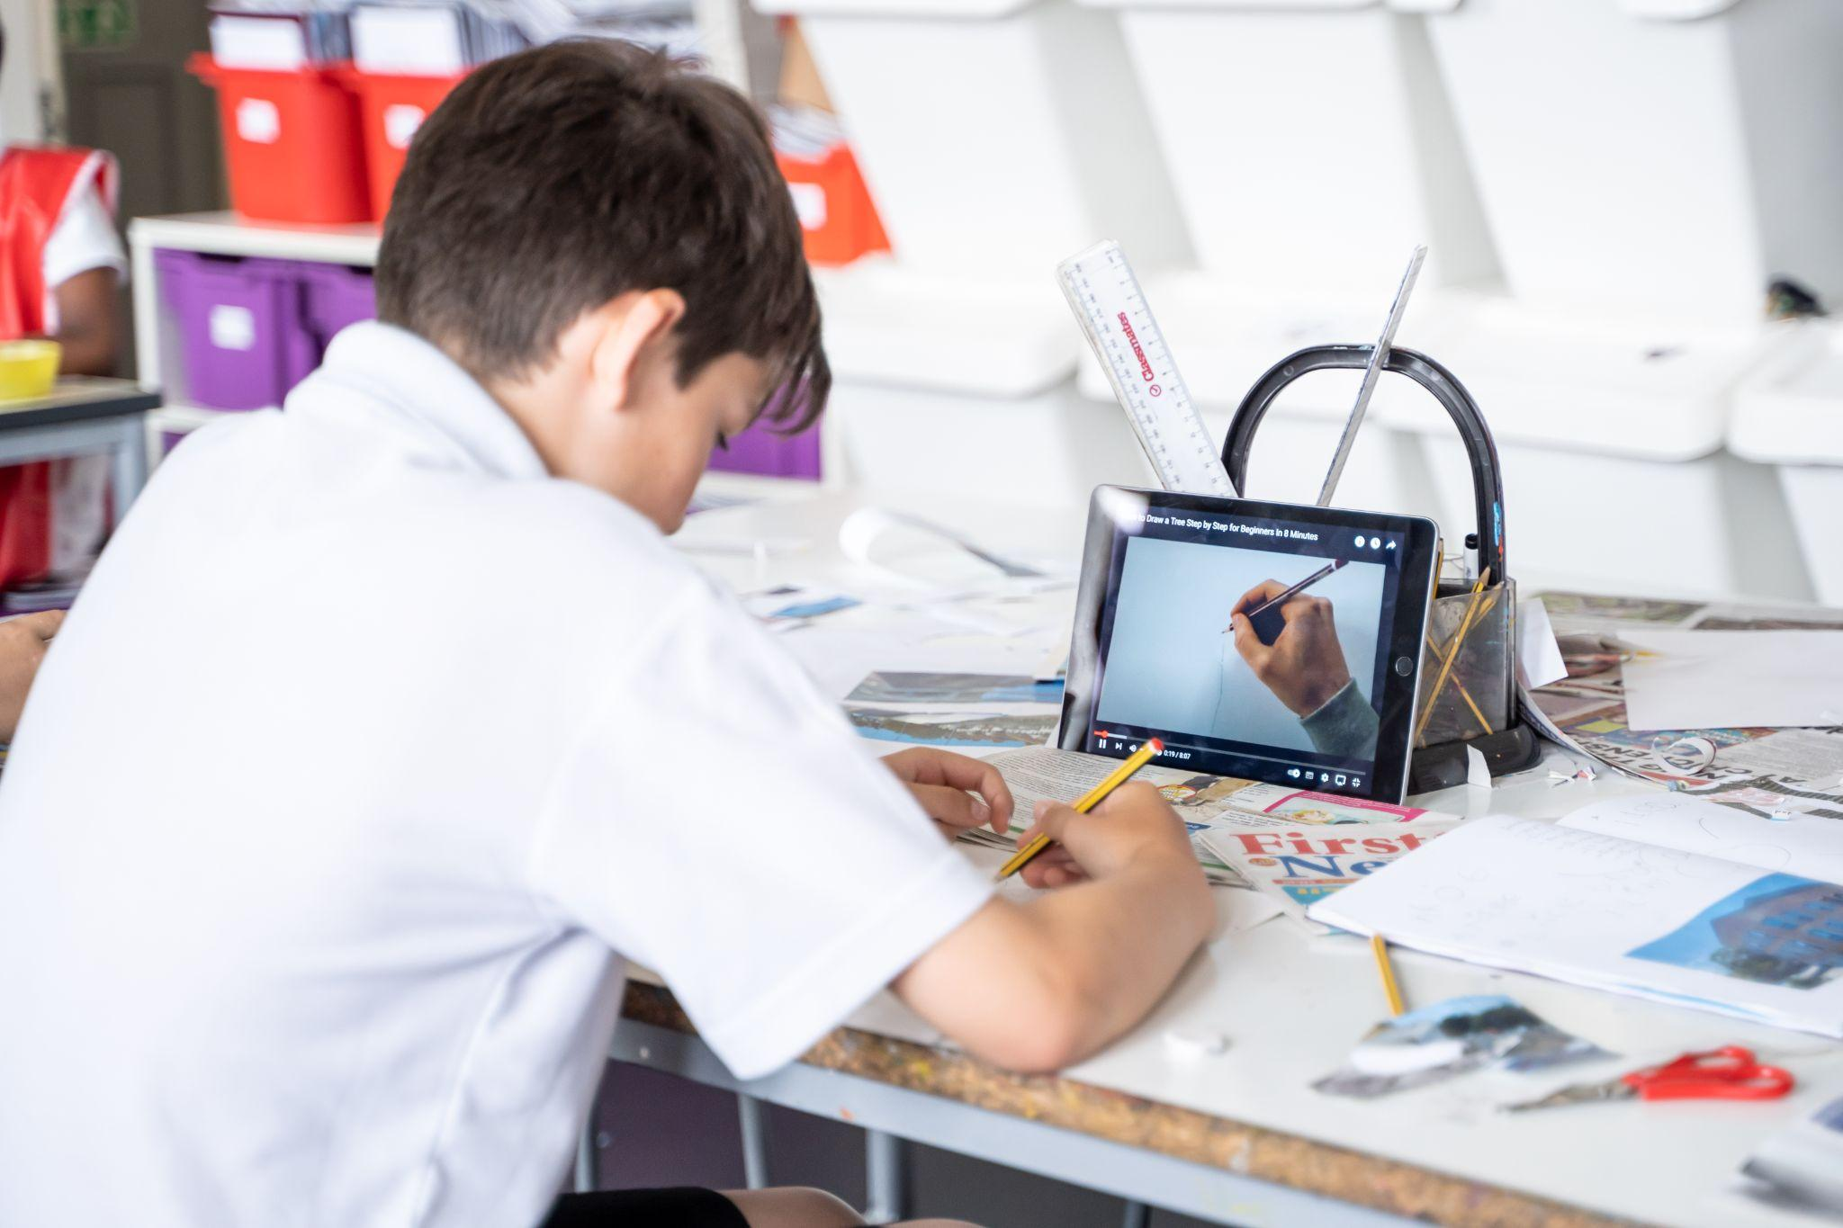

Measuring of impact
Creativity and innovation at the heart of everyday learning
Impact stories

